Slide 1
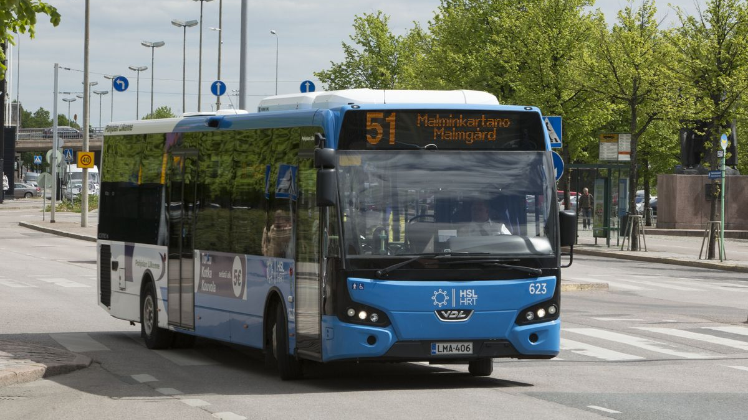

Slide 2
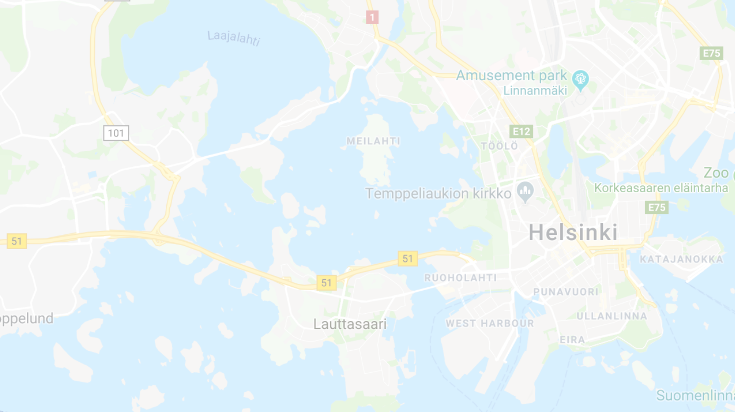
Pasila
Aalto Yliopisto
1
145
Kamppi
Senaatintori

Slide 4
5

Slide 5
7
5
3

Slide 6
7
105
5
3

Slide 7
11
7
55
105
5
3

Slide 8
OPTIBUS PRIME

Slide 9
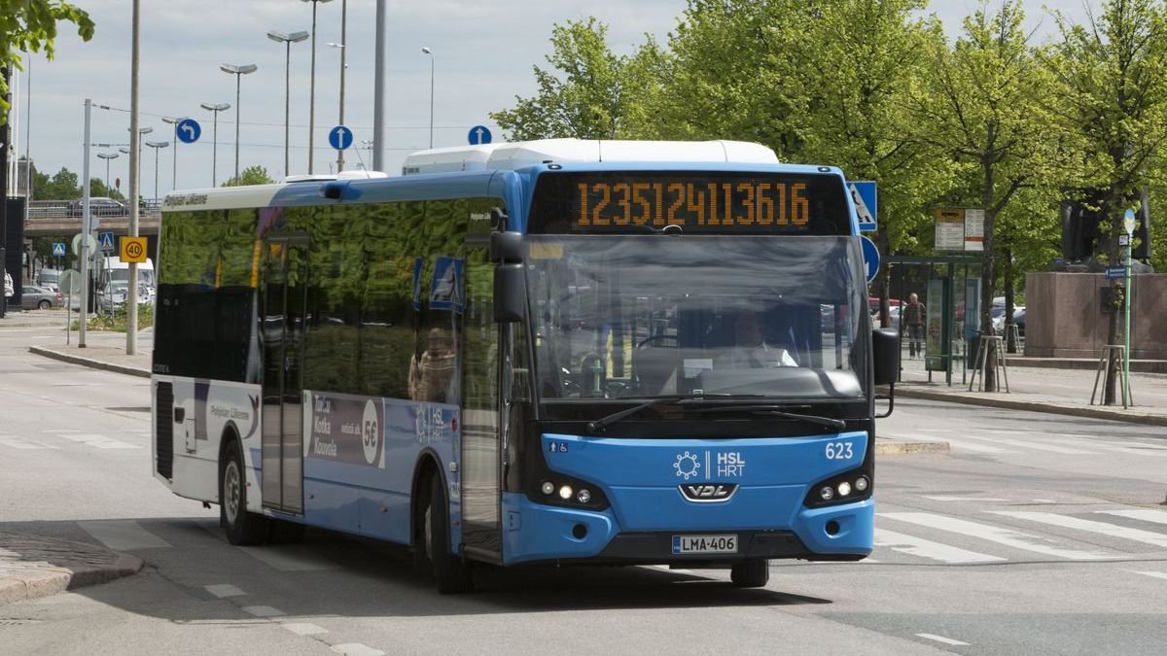

Slide 10
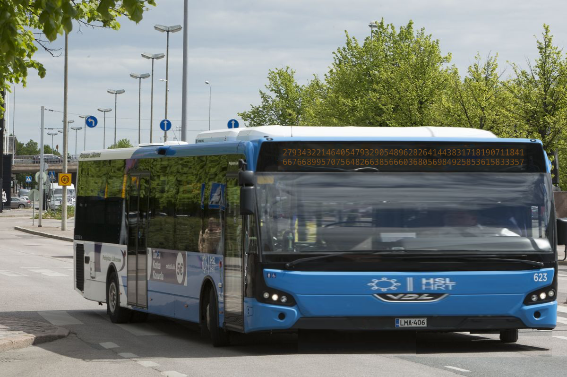

Slide 13

Basemoji™

Slide 14
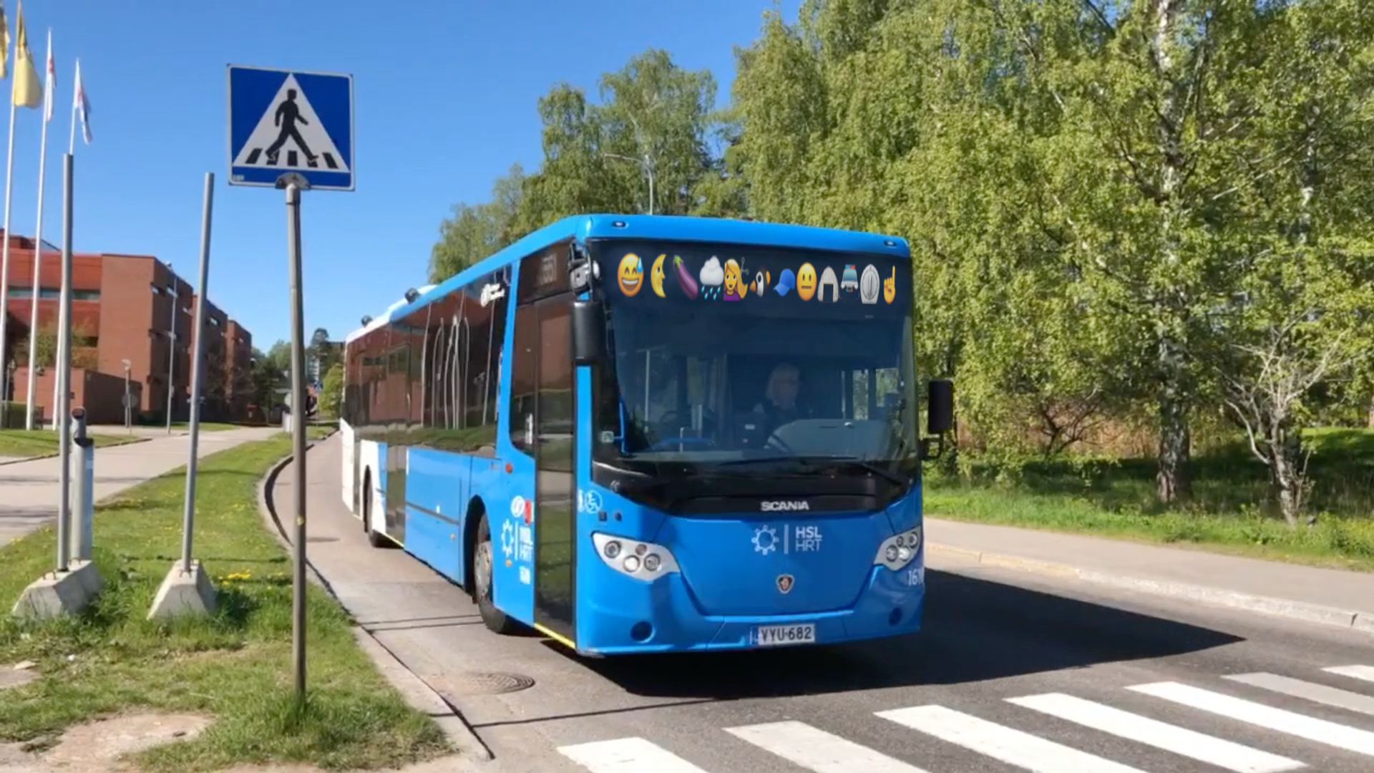

Slide 15
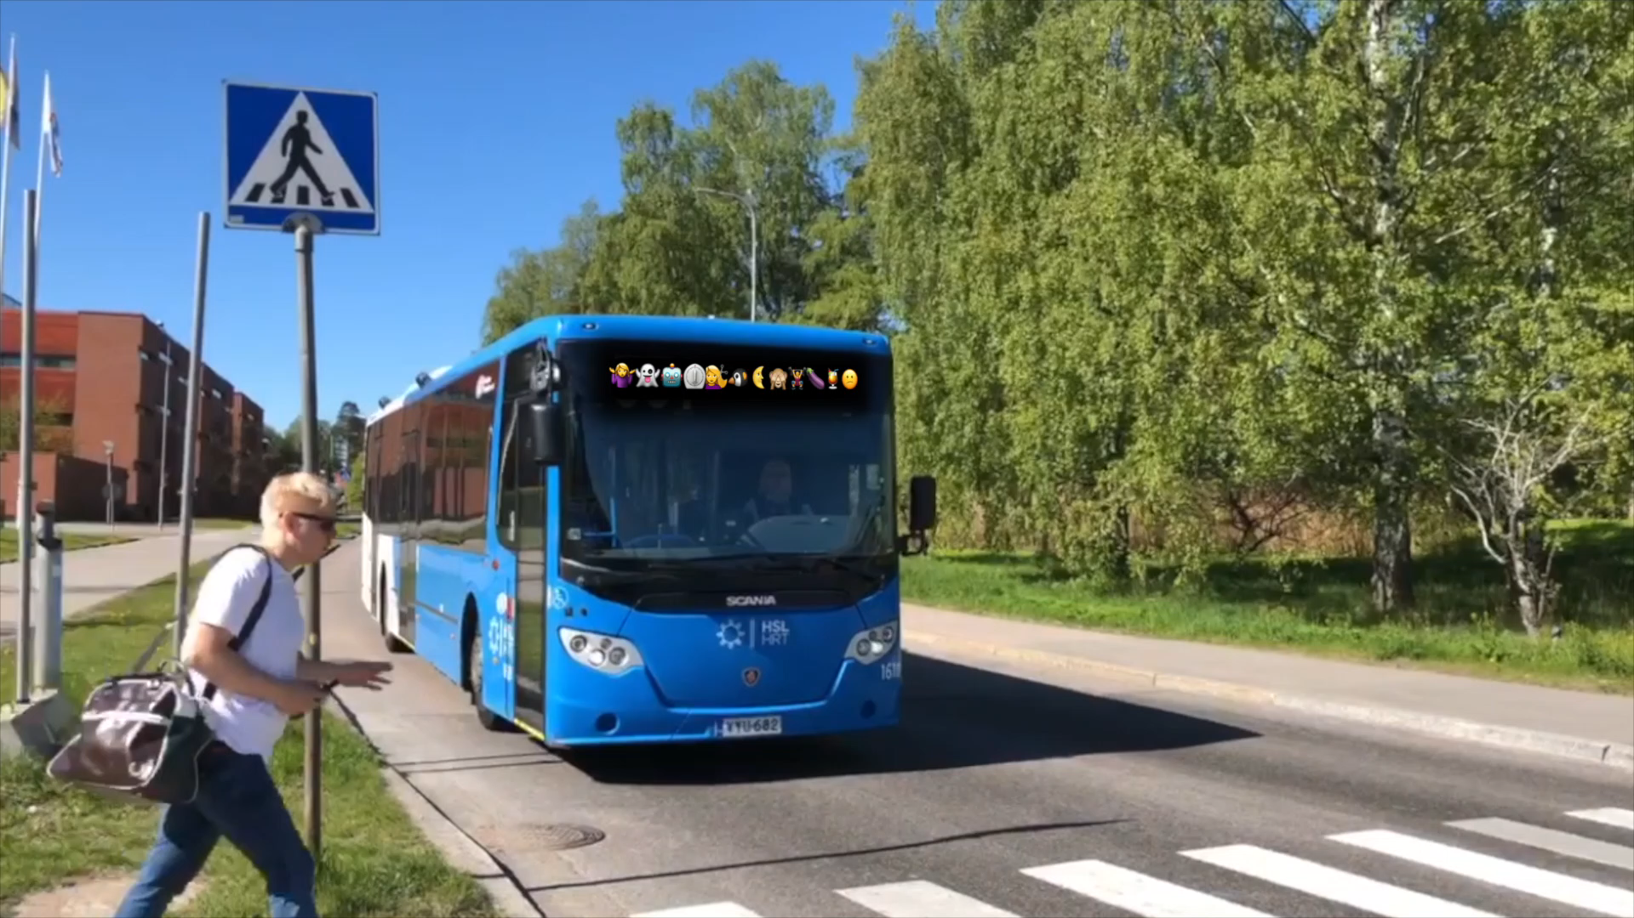

Slide 16
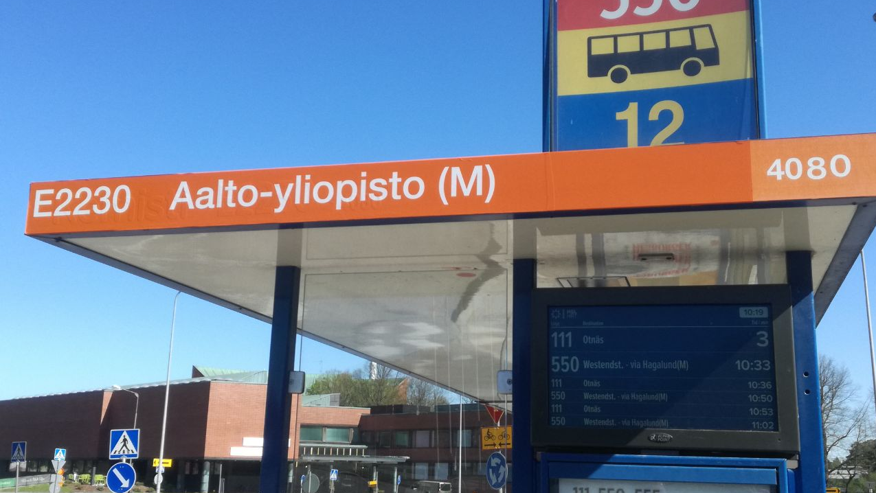

Slide 17
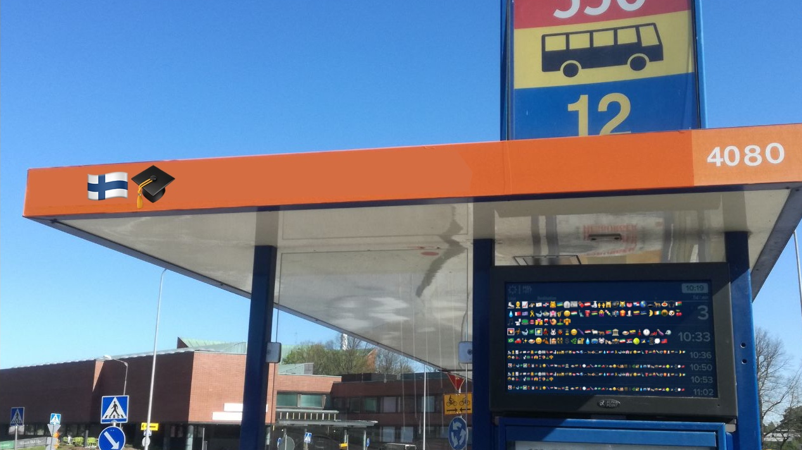

Slide 19
Reittiopas (but wait, you wouldn’t actually need to do that)
Bus stop icons
Catching a bus
Inside a bus, checking when to get off
Calling a friend to say which bus you’re on
Screwed if you have to change lines
Screwed if you don’t know the stationCode before hand
Screwed if you can’t do division

